Slide 1
Nigeria Vs the Democratic Republic of THE Congo
Student’s Name
Institution

Slide 2
Introduction
Nigeria and The Democratic Republic of the Congo (DRC) have both significant economic challenges.
A country must be competitive in the global economy with its exports. This lacks in Nigeria and DRC.
This analysis will examine the comparative economic data for these countries.

Slide 3
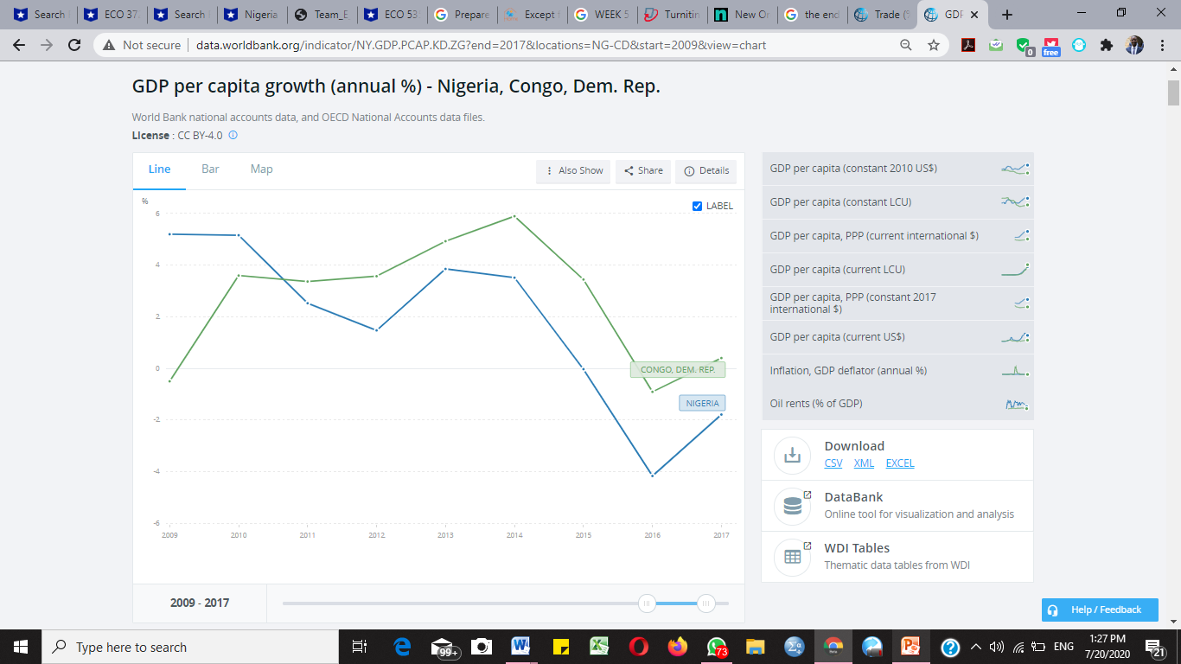
Country GDP per Capita Growth Over-Time
(The World Bank, 2018)

Slide 4
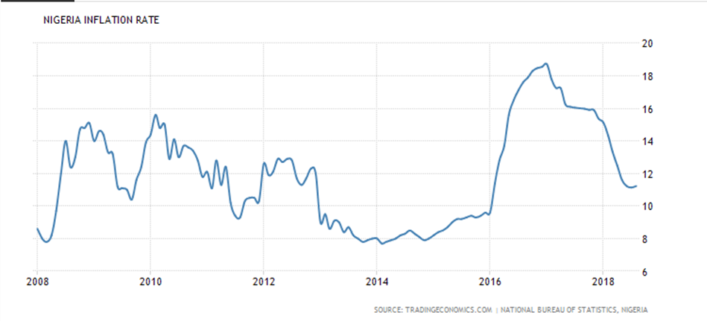
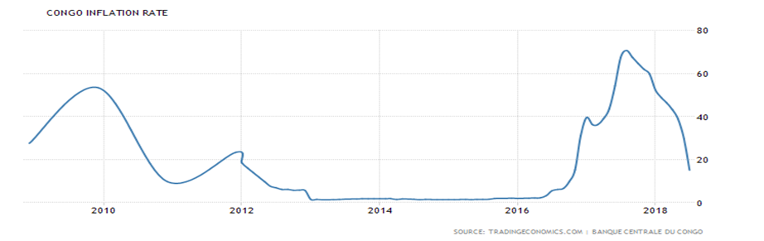
Inflation Rate over time
Nigeria
DRC
(The World Bank, 2018)

Slide 5
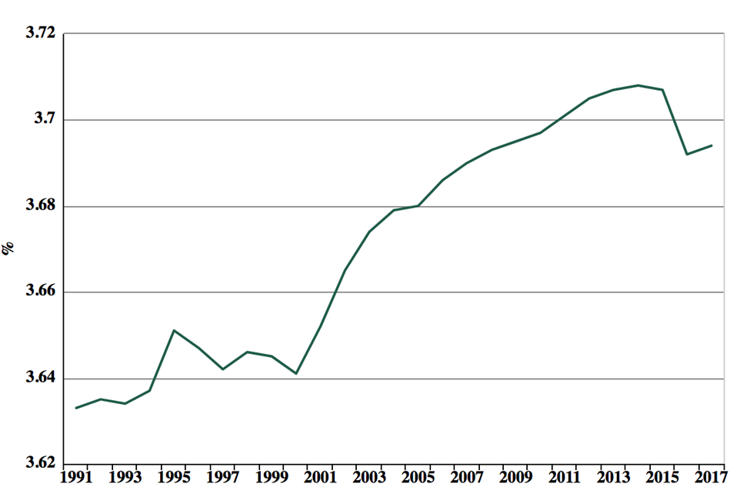
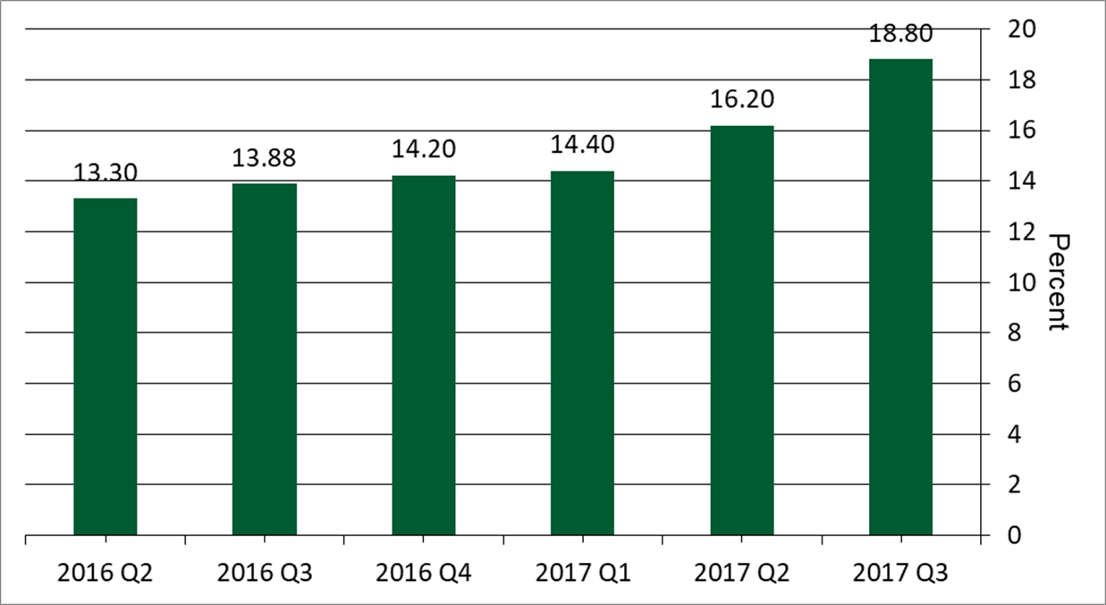
Unemployment Rate
Nigeria
DRC
(The World Bank, 2018)

Slide 6
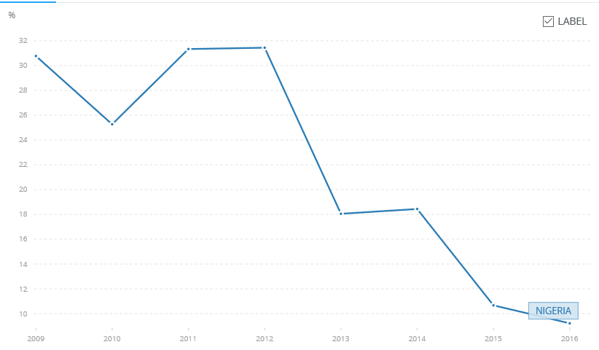
Exports as a Percentage of GDP Overtime
Nigeria
(The World Bank, 2018)

Slide 7
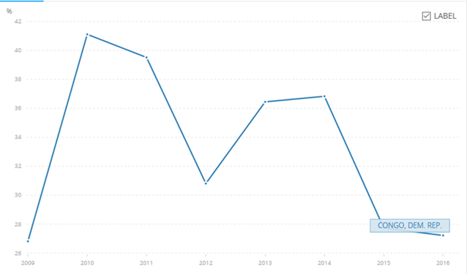
DRC

Slide 8
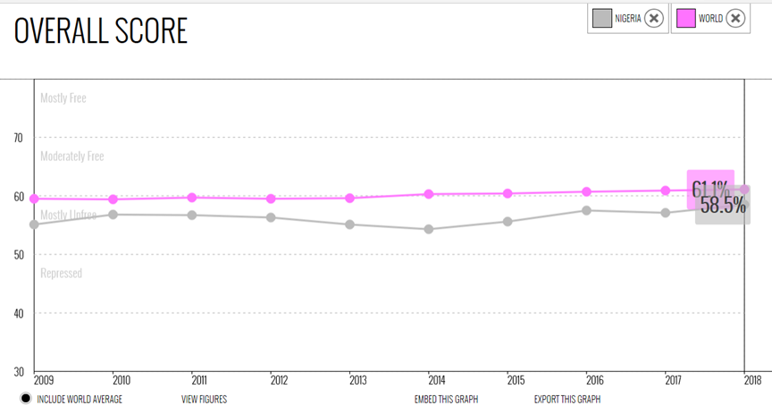
National Government Debt as Percentage of GDP
Nigeria

Slide 9
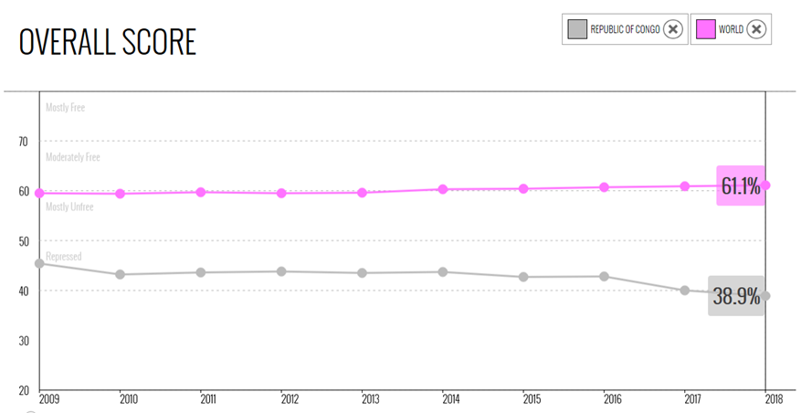
DRC

Slide 10
Reasons for Varied Economic Growth
“The Democratic Republic of the Congo (DRC) has nearly 77 million inhabitants, the DRC is still recovering from a series of conflicts that broke out in the 1990s, creating a protracted economic and social slump” (The World Bank in DRC, 2018).
Nigeria’s civility has been a major factor that influenced its economic growth. “Nigeria is a multi-ethnic and culturally diverse society” (The World Bank in Nigeria, 2018).

Slide 11
Analysis of trade statistic distortion
Value-added trade measures adjust flaws to bilateral trade, minimizing trade with other countries.
Failure to use such data presents practicality and data issues as it will reduce the value of goods.

Slide 12
Products with a Comparative Advantage
Crude Petroleum has clearly provided Nigeria a comparative trade advantage over DRC.
Crude petroleum makes up 73% of Nigeria’s exports, while it is only a mere 5.2% of what is contained in DRC (OEC, 2018).
Refined copper gives Congo the comparative advantage in trade to Nigeria. Copper makes up over 50% of the Congo’s exports, and does not appear to have much trade value at all for Nigeria.

Slide 13
Conclusion
A country’s economy majorly depends on many factors such as are trade, unemployment, GDP, Inflation, Open Trade and Politics.
The explored aspects in Nigeria vs Democratic Republic of Congo indicates the major role played by these factors in economic growth.

Slide 14
References
OEC, 2018. Nigeria. Retrieved from the OEC Website at https://atlas.media.mit.edu/en/profile/country/nga/
OEC, 2018. Democratic Republic of the Congo. Retrieved from the OEC Website at https://atlas.media.mit.edu/en/profile/country/cod/
The World Bank, 2018. Nigeria. Retrieved from the World Bank Website at https://data.worldbank.org/indicator/NE.EXP.GNFS.ZS?end=2016&locations=CD&start=2009
The World Bank, 2018. Democratic Republic of the Congo. Retrieved from the World Bank Website at https://data.worldbank.org/indicator/NE.EXP.GNFS.ZS?end=2016&locations=CD&start=2009
Trade (% of GDP) | Data. (2018). Data.worldbank.org. Retrieved 18 September 2018, from https://data.worldbank.org/indicator/NE.TRD.GNFS.ZS?end=2017&locations=NG-CD&start=1960&view=chart
The World Bank. (2018). GDP per capita growth (annual %). Retrieved from https://data.worldbank.org/indicator/NY.GDP.PCAP.KD.ZG?end=2017&locations=NG-CD&start=2009&view=chart

Slide 15


